Slide 1


Scaling Buzz: Maximizing Social Buzz's Potential with Big Data Expertise and IPO Guidance

Slide 2


Today's agenda
Project recap
Problem
The Analytics team
Process
Insights
Summary

Slide 3

hu
Social Buzz is a fast growing technology unicorn that need to adapt quickly to its global scale.
Accenture has begun a 3 month POC focusing on these tasks –
- An audit of their big data practice
- Recommendations for a successful IPO
- Analysis of Social Buzz’s top 5 most categories of content
Project Recap

Slide 4


Problem
100,000 pieces of content everyday
36,500,000 pieces of content per year
The problem statement is, if there is so much of content, how do we capitalize on it?
Analysis of Social Buzz’s top 5 most categories of content

Slide 5
Andrew Fleming
Chief Technical Architect
The Analytics team
Marcus Rompton
Senior Principle
Roopali Sudra
Data Analyst

Slide 6
Process
1
Data Understanding
2
Data Cleaning
3
Data Modeling
4
Data Analysis
5
Uncover Insights

Slide 7


Insights
16
1897
MAY
Unique Categories
Reaction to Animal Posts
Month with most posts

Slide 8
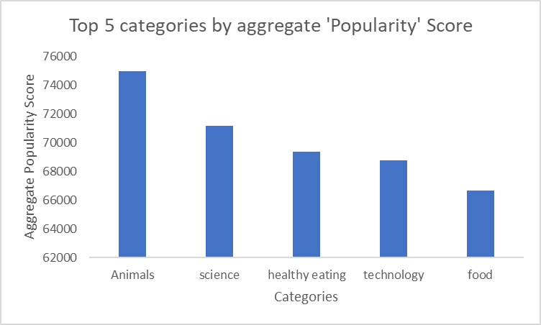

Slide 9
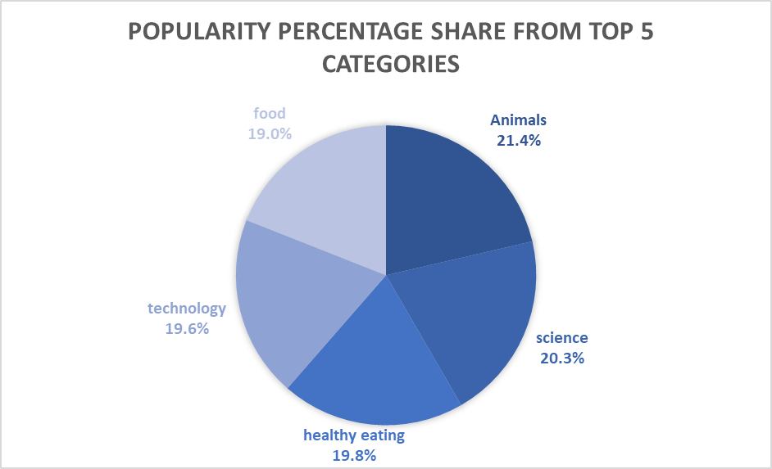

Slide 10

Analysis :
Animals and science are the top 2 most popular category showing that people enjoy ‘real-life’ and ‘factual’ content the most.
Insights :
Food is the common theme with the top 5 categories with ‘Healthy eating’ ranking the highest. This may give an indication to the audience within the user base. You could use this insight to create a campaign and work with healthy brands to boost user engagement.
Summary
Next Steps :
This ad-hoc analysis is insightful, but its time to take the analysis into large scale production for real-time understanding of your business.

Slide 11

Thank you!
ANY QUESTIONS?

